Slide 1
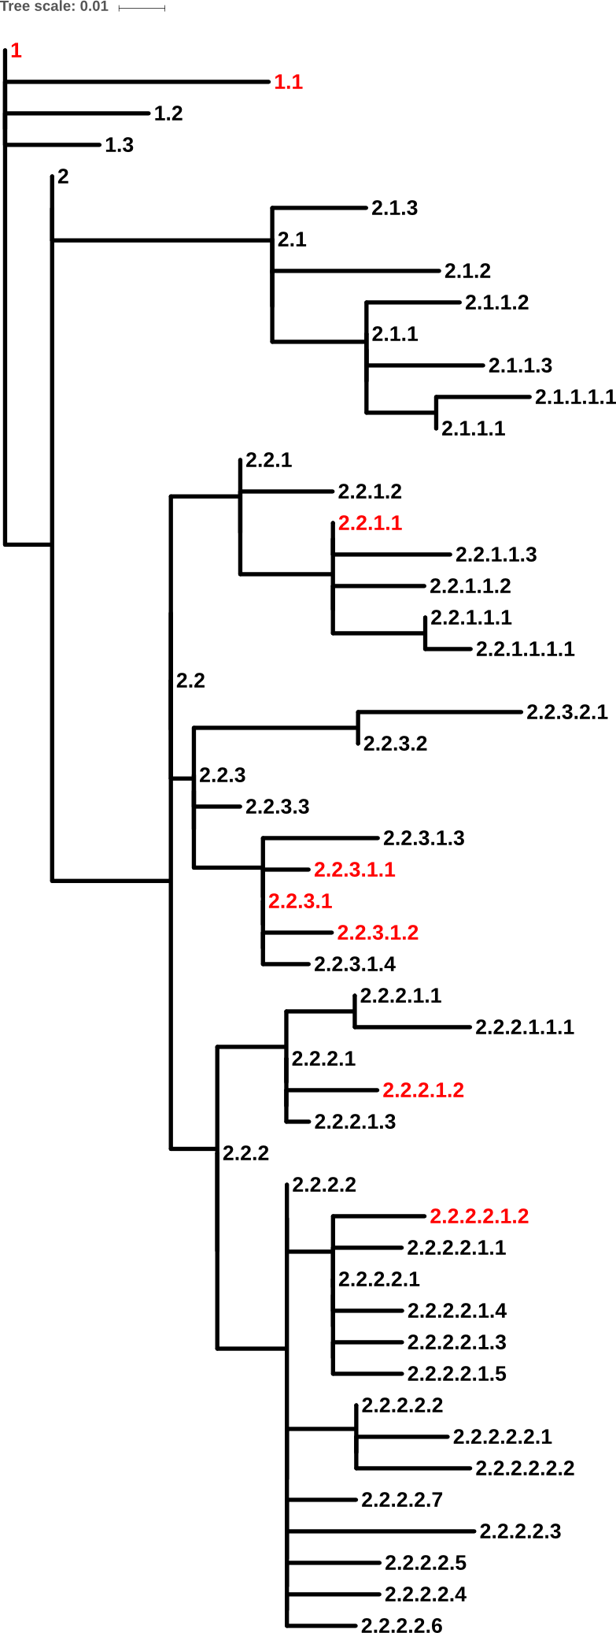
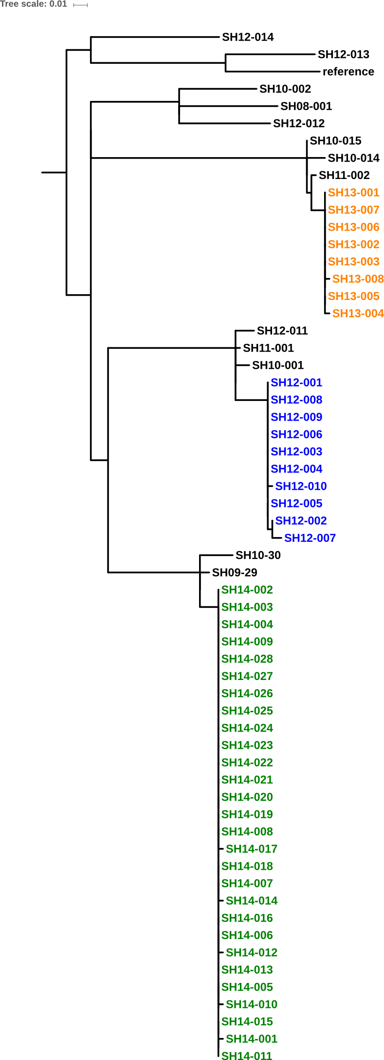
A
B
1
1.1
2.2.3.1
2.2.3.1.2
2.2.3.1.1
2.2.1.1
Outbreak #2
2.2.2.2.1.2
Outbreak #1
2.2.2.1.2
Outbreak #3

